Slide 1

AI-Powered Recommendation Engine
Revolutionizing user experience with intelligent, personalized suggestions.

Slide 2

The Problem: Information Overload
In today's digital landscape, users face an overwhelming amount of choice. Without effective guidance, they experience decision fatigue and often miss out on relevant content, leading to decreased engagement and lost opportunities for businesses.
1
2
3
User Fatigue
Missed Discoveries
Suboptimal Engagement
Too many options lead to indecision.
Valuable content remains hidden from users.
Generic experiences reduce user interest.

Slide 3
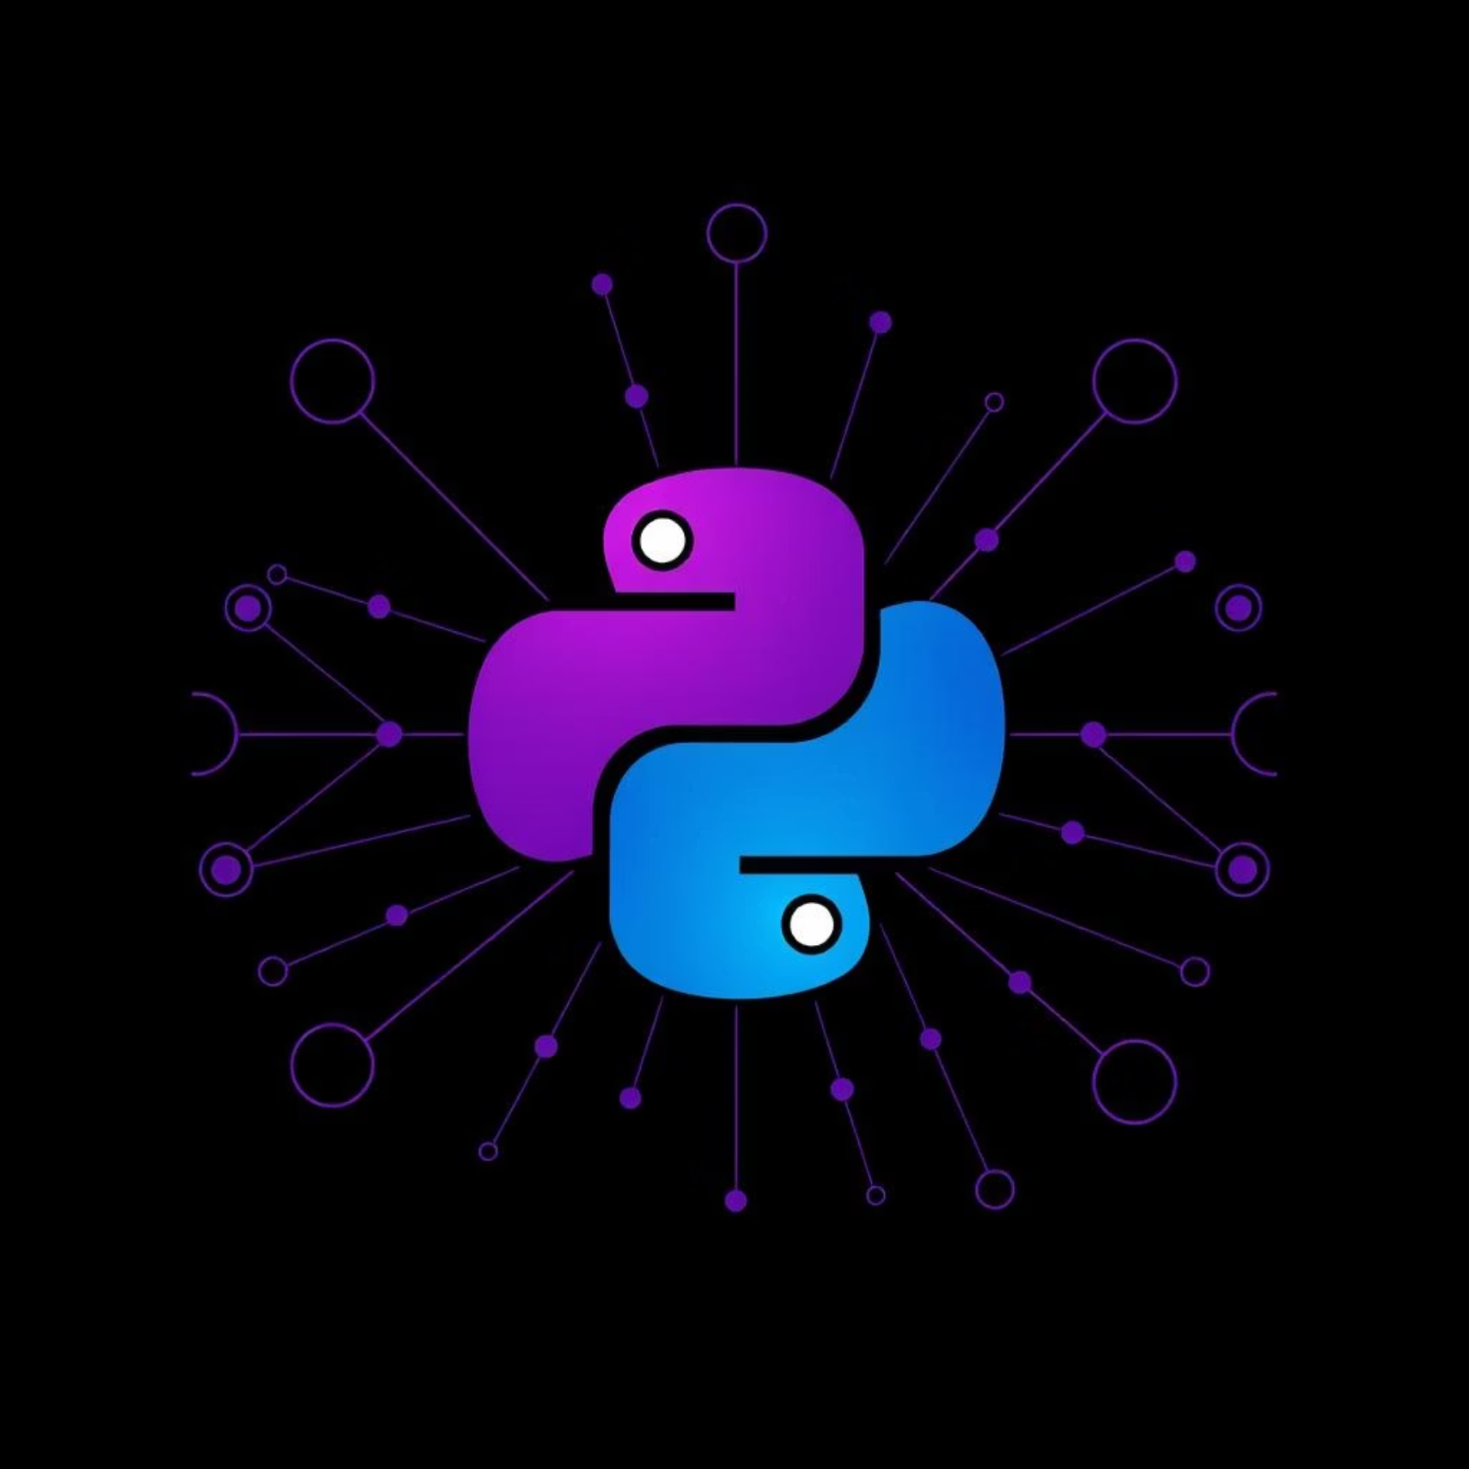
Our Solution: Core Technologies
Python Ecosystem
Scikit-learn: For robust machine learning models.
Pandas/NumPy: Efficient data manipulation and analysis.
FastAPI: Building a high-performance RESTful API.
Leveraging the power of Python and its rich ecosystem of ML libraries ensures a scalable and efficient recommendation system.

Slide 4



The "Wow" Factor: Hyper-Personalization
Our engine goes beyond basic recommendations, offering a truly unique and dynamic experience for each user.
Precision Matching
Discovery Engine
Adaptive Learning
Tailored suggestions based on granular user behavior and preferences.
Uncovers hidden gems users wouldn't find otherwise.
Models continuously evolve with new user data for improved accuracy.

Slide 5
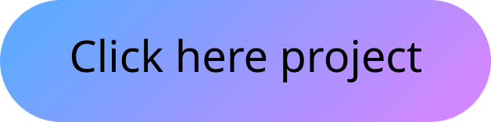
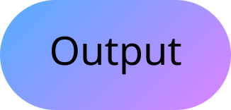
Future Scope & GitHub
Next Steps
Explore the Code
Integration with real-time data streams.
Our project is open-source and available on GitHub. Dive into the codebase, contribute, or adapt it for your needs.
Support for multi-modal recommendations.
Scalability enhancements for larger datasets.

Slide 6
Conclusion
"The future of user experience is personalized. Our AI-powered recommendation engine is ready to shape that future."
Ready to transform your user engagement? Let's discuss how our solution can integrate with your platform.

